Slide 1











TAP
Day 2 Morning – January 13, 2026

Slide 2
Welcome Message
Patrick Sullivan, President & CEO
Halifax Chamber of Commerce

Slide 3
REFINING YOUR VALUE PROPOSITION
Dave Archer

Slide 4
CANADIAN TRADE COMMISSIONER SERVICE
Global Affairs – Alex Lanteigne

Slide 5








How We Help
Gain Market Insight
The TCS offers key market insights and practical business advice
Connect with Key Contacts
The TCS connects Canadian businesses with qualified contacts
Find New Opportunities
The TCS opens the door to international business opportunities
Resolve Business Problems
The TCS helps resolve problems in foreign markets
As a result:
Expand into New Markets
The TCS helps Canadian businesses navigate the complexities of entering new markets
Reduce Risks
The TCS helps Canadian companies to:
reduce risks and avoid costly mistakes
make better informed and more socially and environmentally responsible business decisions

Slide 6
When to Engage the Trade Commissioner Service
Who can we help?
If you are…
part of the Canadian business community (small, medium, or large);
have meaningful ties to Canada (e.g. are incorporated, have employees, develop IP, etc.);
have demonstrated your ability to internationalize (completed export plan, dedicated resources); and,
show good potential to add value to the Canadian economy…
you likely qualify as a TCS client.
When are we best positioned to help you?
You have an export plan to focus your IBD efforts (including target market(s), entry strategy, SMART objectives);
You have undertaken market research and understand the basic dynamics and conditions of your target market(s) (e.g. size/opportunity, competitors, regulatory considerations, etc.);
Have reached the point where you are looking to validate those market assumptions and/or are seeking assistance in the execution of your market entry strategy (e.g. introductions to potential partners).

Slide 7
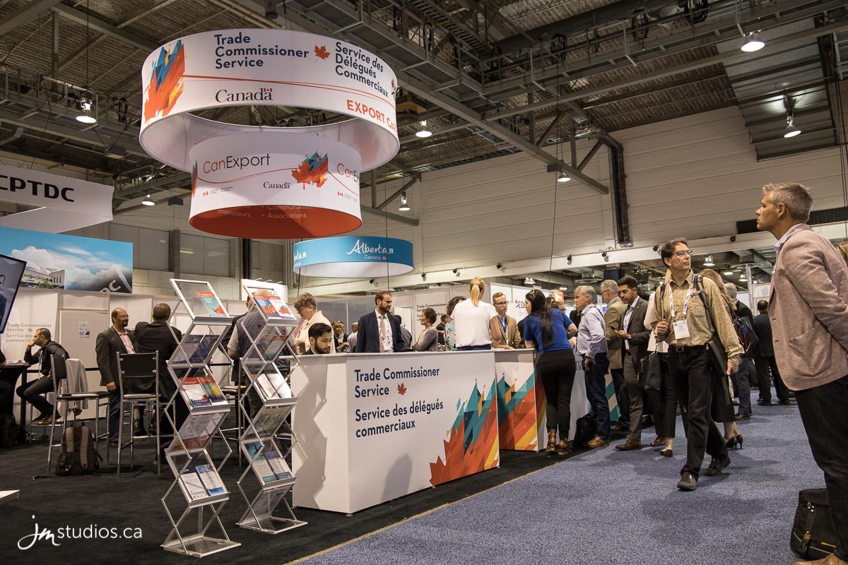
Trade Events, Webinars, and Training
We leverage trade events to give companies custom business programs that help them stand out and connect with
international partners. With access to the Canadian pavilion, business meetings, and networking events, we can help you
unlock international opportunities.
Find more information on upcoming trade events, webinars, and training at:
https://www.tradecommissioner.gc.ca/en/trade-events-training.html
(Search “Trade Commissioner Service Events” in the browser of your choice)
Find tips to help maximize your success at trade events at:
https://www.tradecommissioner.gc.ca/en/trade-events-training/tips.html
(Search “TCS tips for success at Trade Events”)

Slide 8


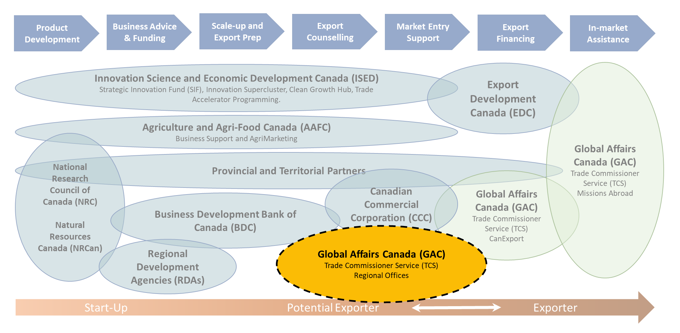






REGIONAL OFFICES – PARTNER COLLABORATION
for International Business Development
The RO Network works closely with other federal departments, Canada’s Regional Development Agencies, provincial/territorial governments, municipal governments, non-government organizations, as well as private sector partners such as business associations, business councils, chambers of commerce, think-tanks, academia, etc.
Outcalls & cross referrals
Strategy collaboration
Employee exchanges
Outreach coordination
Information exchange
Sharing international business leads
Co-financed programs & events
Meetings & joint committees
8

Slide 9
Helpful Resources
Step-by-Step Guide to Exporting
Exporting to the U.S. – A Guide for Canadian Businesses
IP Consideration for Canadian SMEs in the U.S.
Guide: Spotlight on E-Commerce
Business Benefits Finder
Tariff Finder
Trade Missions & Events

Slide 10


Q&A

Slide 11




Accelerated growth service
Innovation Canada – Rejean Belliveau
*Virtual*

Slide 12





Q & A

Slide 13
BREAK

Slide 14
WORKSHOP:
Trade Resources

Slide 15






WORKSHOP
TRADE RESOURCES – GROUP 1
You have potential clients lined up in Vietnam but you had not chosen this market as a priority. You have a potential order now, but it’s not enough to justify travelling there – but you believe there may be more opportunities that could come of it.
What do you do?

Slide 16
WORKSHOP
TRADE RESOURCES – GROUP 2
You are planning to go on your first in-market visit and would like to enlist the services of the Canadian Trade Commissioner Service.
Write an email to explain your objectives.

Slide 17
WORKSHOP
TRADE RESOURCES – GROUP 3
You will be exhibiting at a trade show in your selected target market.
How do you plan and prepare for the trade show?
How do you work your booth?
How do you manage and follow up your leads?

Slide 18
Export development canada
Paul de Bellefeuille
*Virtual*

Slide 19
Q & A

Slide 20





MARKETING LOCALIZATION BRAND AWARENESS BUILDING DIGITAL MARKETING ECOMMERCE
Heather Brewer - CPA Atlantic

Slide 21




Marketing that Matters

Slide 22
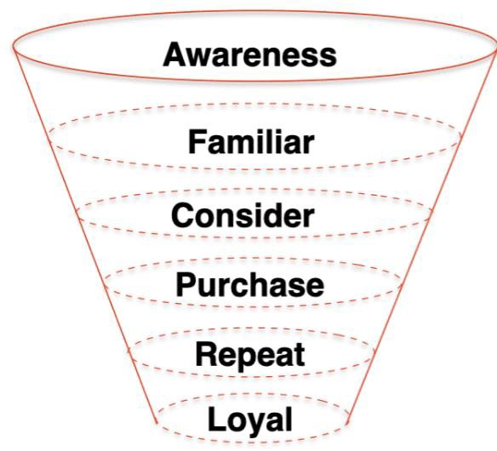
The Marketing Funnel

Slide 23







How Channels fit in the Funnel
Awareness/Interest (Acquisition) | TV, Radio, Out-of-Home, Events, External blogs, Outside recommendations, Paid social ads, Paid digital display ads
Consideration/Evaluation (Acquisition) | Organic social media, emails, newsletter, Website
Decisions/Purchase (Acquisition) | Paid Search, Website
Repeat/Loyalty (Retention) Loyalty (Retention) | Organic Social, Email, Newsletter, Surprise and Delight Organic Social, upgrade offers, surprise and delight
Advocacy (Retention) | Outreach, special offers, gifts

Slide 24

Why it Matters
▶ Customers need between 5-20 (with the agreed upon average being 12) touchpoints to move through the funnel from awareness to a purchase.
▶ Different messaging for each stage of the
funnel is required
▶ While ROI is harder to measure for channels higher in the funnel, they are required to move potential customers to conversion - we can’t start at the bottom.

Slide 25

Digital Marketing
▶ Paid vs. Organic Social media - awareness
and conversion vs. brand engagement
▶ Organic social media is not a sales driver.
▶ Digital Display ads
▶ Google ads
▶ These are conversion ads
▶ SEO
▶ Determines where you show up on Google based on keyword queries
▶ Blogs
▶ Email
▶ Website content

Slide 26
Building Brand Awareness
▶ Before you start to think about brand awareness, you first need to have a strong handle on your brand, your customer, and your competition. A brand DNA exercise is a great place to start
▶ While many associate the awareness part of the funnel with pricey advertising campaigns, there are low-budget alternatives
▶ Hijacking traffic (Google ads)
▶ Strong SEO
▶ Leveraging the popularity of others
▶ Events/Awards
▶ Earned media

Slide 27

Brand DNA
▶ Who are you? What problem do you solve?
▶ Who is your customer?
▶ Who is the competition?
▶ What is your positioning statement?
▶ How are you different?

Slide 28

Who are you?
Creating a brand persona, visual identity, and tone is key to brand health, brand recall, and affinity. This is our Brand DNA… So who are you?
▶ Visual Brand Identity
▶ Brand Voice
▶ Brand Values
▶ Brand Message
▶ How do we want people to feel
▶ Our Story
▶ Brands we admire

Slide 29
Who is
your customer?
▶Before we can start marketing, it is crucial that we understand who we are marking to. This doesn’t just mean demographics, but also psychographics
▶What are their goals?
▶What’s important to them?
▶What are their values?
▶How do they prefer to receive information?
▶What are their pain points?
▶What are their barriers to purchase?
Building an
avatar

Slide 30
The old method was “We create (blank) for (blank) so they can (blank). These were often drafted, tucked in a drawer, never to be seen again.
April Dunford drafted a new model in her book “Obviously awesome” that is much more useful to an organization.
▶How do you solve a problem for the customer?
▶How do you do it better than the competition?
▶Who is the market that cares?
▶Now bring it all together in one statement
Positioning

Slide 31

The Competition
▶How does competition represent themselves in the market? What brand characteristics to our competitors have?
▶Difference mapping helps us understand where we play in the market.
▶Bernadette Jiwa has an excellent template

Slide 32
Difference Mapping
▶Purpose: Why do we exist?
▶People: Who is this for?
▶Personal: How can we help people live
better lives
▶Perception: What do they believe? What do we want them to believe?
▶Product: What do people really want
or need? How do we create that value?

Slide 33

Localized Marketing
▶ Localized marketing is all about connecting with your audience using language and visuals that resonate with them.
▶ It is also critical to understand how your market prefers to interact with brands
▶ Images of local landmarks, references to local cuisine, leveraging local slang, even throwing the name of the region into the creative.
▶ Large companies will often have dozens of iterations of the same campaign creative, adjusting only the local references.

Slide 34
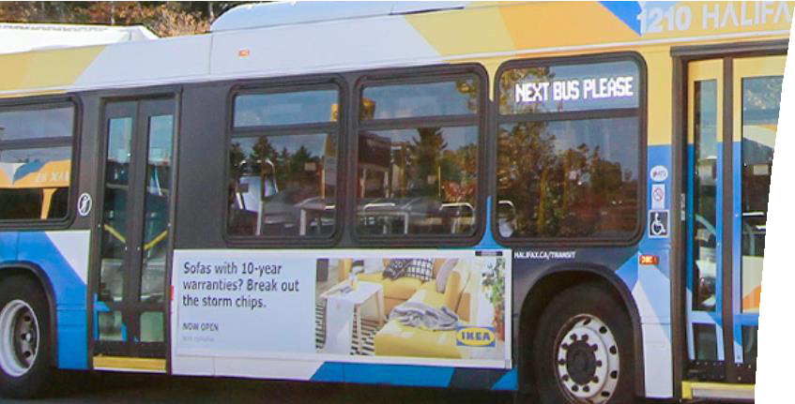


Localized Marketing Examples

Slide 35

e-Comm considerations and challenges
A full-view marketing strategy is a must: How are you driving customers from the top of the marketing funnel to the bottom?
Do you understand how your audience interacts with your website
Are you familiar with tiered paid social ads?
Does your site have a pixel?
Do you encourage additional point of sale purchases?
Do you understand the pain points of the customer both in using the site and in completing their purchase?

Slide 36

Do you Know the Score
▶ How are you tracking your success?
▶ Identify the metrics that matter
▶ Develop dashboard to track wins and losses
▶ Observe trends over time
▶ Key metrics to track to measure overall funnel health:
▶ Ad clicks/Reach/Impressions
▶ ROAS/CPC
▶ Followers
▶ Engagement
▶ Web visits/time on site/bounce rate
▶ Email open rate/CTR
▶ Conversion rate/abandoned carts/average ticket

Slide 37
Q & A

Slide 38
LUNCH

