Slide 1



TAP ATLANTIC 2026
Day 1 – January 12, 2026

Slide 2




Meet the Facilitators
Dave Archer, The Export Coach – Lead Facilitator
Kristen Rivers, Invest Nova Scotia – Business Growth Executive
Sandra Thomson, Halifax Chamber of Commerce – Event Manager

Slide 3
AVERAGE EXPORT SALES RESULTS ATTAINED BY TAP COMPANIES (pre-Covid)
This is the
Canadian average
Data based on measured average export growth rate among participants
of 33%, extrapolated over 18 years. For illustrative purposes only.
* Source: World Bank, Cambridge Calculations, 2019

Slide 4
Key TAP Statistics
2,000+ TAP graduates over four years
40 countries entered
70% chose non-US target markets
8,000+ jobs created across Canada … and counting
Within three years after graduation the average TAP company will have:
Tripled its export sales
Doubled its overall sales
Created 4 jobs

Slide 5
TAP SUCCESS STORY VIDEO
: https://vimeo.com/594760156?&login=true

Slide 6
COMPANY INTRODUCTIONS

Slide 7
INTRODUCTIONS
Your Name
Company Name
What do you do?
Ideal Customer
Value Proposition
Planned Target Export Market

Slide 8
CASE STUDY & WORKSHOP:
International Market Entry Strategies

Slide 9
CASE STUDY
MARKET ENTRY STRATEGY
Your company just got a hot e-lead via your website from a potential buyer in Germany. They want your service, and if the sale is finalized it would be worth $120,000 to your company’s bottom line. Your head salesperson is excited and is pushing you hard to complete the deal.
What do you do next?

Slide 10
INTERNATIONAL MARKET ENTRY: 4 + 1 MAIN OPTIONS
Market Entry Methods
Trading Entry Strategies
E-commerce
Investing Entry Strategies
Indirect Exporting
Direct Exporting
Partnership
Foreign Direct Investment
Licensing
Subcontracting
Branch Office
Greenfield Investment
Franchising
Loose Strategic
Alliance
Merger & Acquisition
Joint Venture

Slide 11
WORKSHOP:
International Market Entry Strategies

Slide 12
MARKET ENTRY STRATEGY – GROUP 1
SELLING DIRECTLY TO END USERS VS SELLING THROUGH INTERMEDIARIES
What key factors make it appropriate to sell directly to your consumers and which ones would indicate that selling through some form of intermediary / distribution channel is appropriate?
Summarioze the pros and cons of selling direct, vs through distribution channels / intermediaries or eCommerce?
What different forms of intermediaries are available to exporters, and how do they differ?
Provide one example of a company that should be exporting directly and one example of a company that should be selling through distribution.

Slide 13
MARKET ENTRY STRATEGY – GROUP 2
PARTNERSHIP VS FOREIGN DIRECT INVESTMENT
What forms of partnership that may be available to exporters entering a new foreign market?
What options may be available to companies that are willing and able to enter a market on their own?
What are the pros, cons, and risks of entering a market in these modes?
Provide examples of one company each that should consider FDI, and partnership

Slide 14
MARKET ENTRY STRATEGY – GROUP 3
E-COMMERCE/DIGITAL MARKETING
Describe the factors that would indicate that a company should be using e-commerce/ digital marketing rather than the traditional methods
Describe the pros and cons of this sales channel, and provide an example of a company that should be using this channel

Slide 15



Groups Present Their Findings

Slide 16
BUSINESS MODEL CANVAS

Slide 17
Business Model Canvas
Now let’s talk about you!
33
Notes:
https://www.youtube.com/watch?v=wlKP-BaC0jA

Slide 18
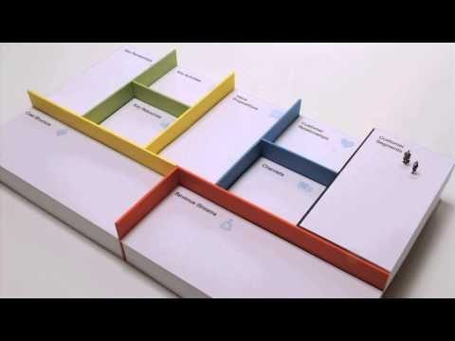
The BMC Explained
https://www.youtube.com/watch?v=wlKP-BaC0jA&t=10s
34

Slide 19
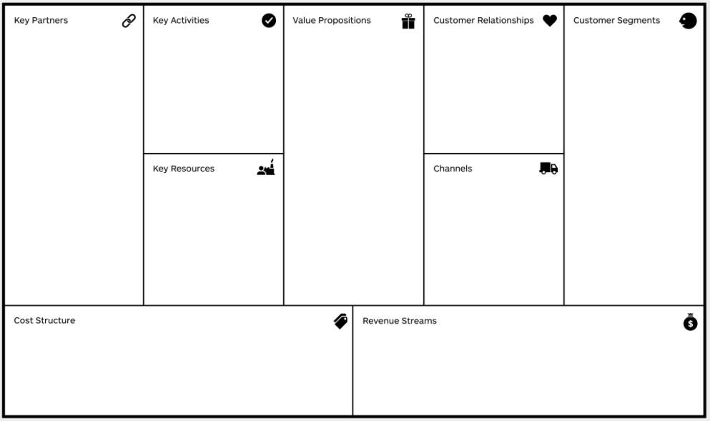
Business Model Canvas
36

Slide 20








The Business Model Canvas
Designed by:
8. key partners | 7. key activities | 2. value propositions |  | 4. customer relationships | 1. customer segments ➔ For whom are we creating value? ➔ Who are our most important customers? Mass Market Niche Market Segmented Diversified Multi-sided Platform
➔ Who are our Key | ➔ What Key Activities do our | ➔ What value do we deliver to |  | ➔ What type of relationship does
Partners? | Value Propositions require? | the customer? |  | each of our Customer
➔ Who are our Key | Our Distribution Channels? | ➔ Which one of our |  | Segment expect us to
Suppliers? | Customer Relationships? | customer’s problems are |  | establish?
➔ Which Key Resources | Revenue streams? | we helping to solve? |  | ➔ Which ones have we
are we acquiring from | CATEGORIES | ➔ What bundles of products |  | established?
partners? | Production | and services are we |  | ➔ How costly are they?
➔ Which Key Activities do partners perform? | Problem Solving Platform/Network | offering to each Customer Segment? ➔ Which customer needs are |  | Personal assistance, Self-service, Automated Services, Communities
MOTIVATIONS FOR PARTNERSHIPS Optimization and economy Reduction of risk and uncertainty Acquisition of particular resources and activities | 6. key resources ➔ What Key Resources do our Value Proposition require? Our Distribution Channels? Customer Relationships? Revenue Streams? TYPES OF RESOURCES Physical Intellectual (brand patents, copyrights, data) Human Financial | we satisfying? CHARACTERISTICS Newness Performance Customization “Getting the Job Done” Design Brand/Status Price Cost Reduction Risk Reduction Accessibility Convenience/Usability |  | 3. channels ➔ Through which Channels do our Customer Segments want to be reached? ➔ How are we reaching them? ➔ Which ones are most cost-efficient? PHASES: Awareness, Evaluation, Purchase, Delivery, After Sales TYPES: Sales force, Web sales, Own stores, Partner stores, Wholesaler
9. cost structure ➔ What are the most important costs inherent in our business model? ➔ Which Key Resources are most expensive? ➔ Which Key Activities are most expensive? IS YOUR BUSINESS MORE Cost Driven (leanest cost structure, low price value proposition, maximum automation, extensive outsourcing) or Value Driven (focused on value creation, premium value proposition) SAMPLE CHARACTERISTICS: Fixed Costs (salaries, rents, utilities), Variable costs, Economies of scale, Economies of scope |  |  | 5. revenue streams ➔ For what value are our customers really willing to pay? ➔ For what do they currently pay? ➔ How are they currently paying? ➔ How would they prefer to pay? ➔ How much does each Revenue Stream contribute to overall revenues? TYPES: Asset sale, Usage Fee, Subscription Fees, Lending/Renting/Leasing, Licencing, Brokerage fees, Advertising
Date:
Version:
37

Slide 21
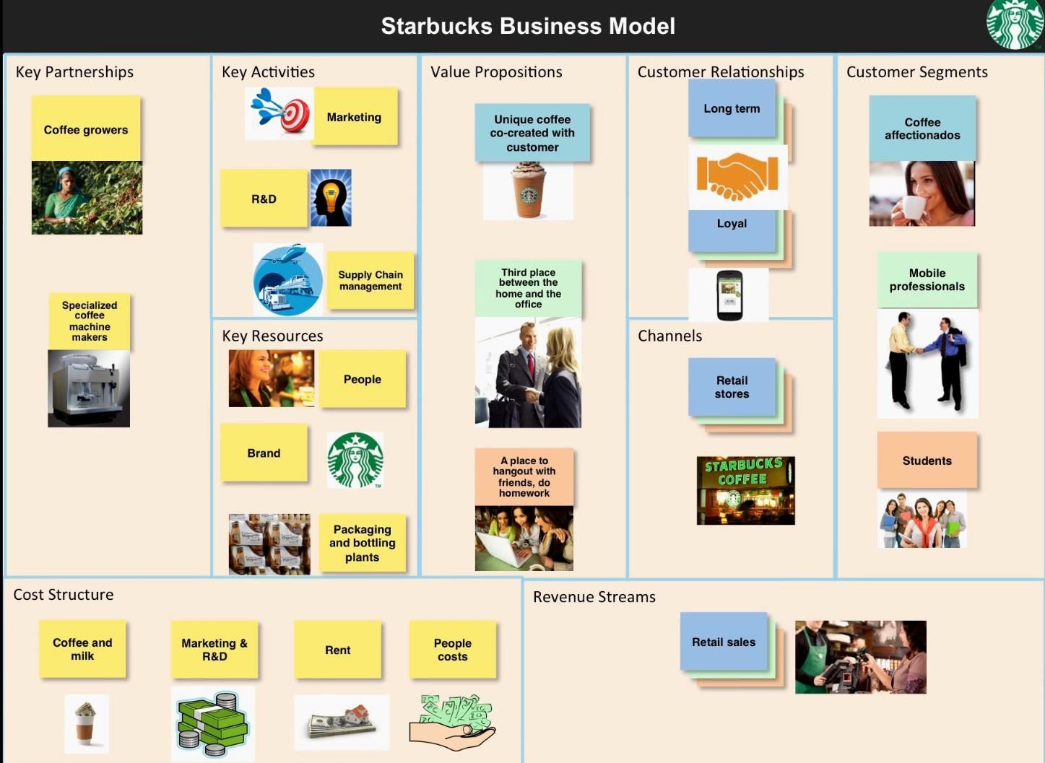
38

Slide 22
WORKSHOP:
Sketch out Business Model Canvas

Slide 23
Review:
Export Plan Template

Slide 24
Day 2 Tomorrow:
Val prop review – be ready!
Government services
Trade resources
Marketing abroad
International SALES!
Legal & tax considerations
Start time: 8:15am

Slide 25
SURVEY – DAY 1
Notes:
Sandra to send QR code

